Slide 1
Spring Form
Break the Taboo: A Forum on Youth Mental Health & Substance Use Disorder
May 19, 2022
Jennifer Bienstock, Psy.D.
Center for Anxiety and Behavioral Change

Slide 2
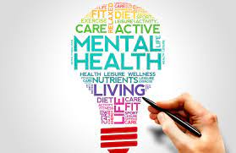
MENTAL HEALTH MATTERS
Notes:
Anxiety is a shadow of a strength,
Shadow of great virtues
intelligence, creativity and compassion, and probably a lot of other ones
When you have these three things, they usually throw anxiety in there to the mix as well.
We want to give people the owners manual to their nervous system.
They can learn to cope effectively in tough situations
When we give people tools, resources, evidence based skills to cope with their anxiety, these 3 virtues can really shine through,
I’d really like everyone of this as a learning opportunity
These individuals are learning about themselves in the world, learning how to pursue values, things that are challenging and not just their comforts,
Learning how to be comfortable being uncomfortable in novel and new situations, like the one we are in now with COVID. Even though we are 2 years into it, there are new challenges that come up
Therapy and other ways of learning - its about Life skills, not just anxiety management skills - now its zoom and covid but down the road its going to be about interviews, applying to specialty programs, standardized tests, tryouts for sports teams and recitals etc.
Not all anxiety and stress warrants formal treatment in the for of therapy with a licensed clinician. Some individuals can get support from trusted parents, teachers, school personnel, members of their religious community or sports team. When the symptoms appear to be causing more disruption and distress than what we would consider to be age or context appropriate, then it might be time to seek out more support.

Slide 3
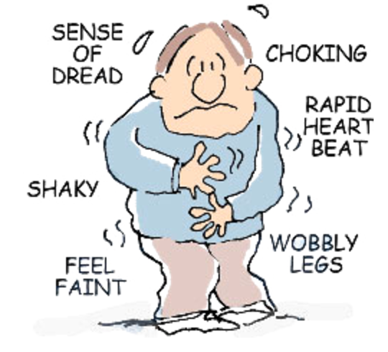
How Mental Health Issues Can Manifest
Anxiety
Stress
Substance use
Depression
Thoughts/actions of self harm
Isolation and withdrawal
Overperformance
Notes:
MH symptoms can manifest in a variety of ways
I would like to take a minute to just note that people who hold different identities, whether that be cultural, ethnic, religious, gender based may present with mental health concerns in different ways. There are some spaces that may not be safe or appropriate for individuals to express their thoughts and feelings. I wish I could spend an entire talk on how mental health presents itself among different groups but that will have to be a talk for another day

Slide 4
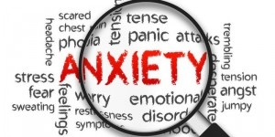
Adaptive Anxiety vs.
Disordered Anxiety
Adaptive Anxiety
Disordered Anxiety
Keeps us safe
A response to real danger
Prevents the repeating of mistakes
Results in functional impairment
Equivalent to a “false alarm”
Leads to unnecessary avoidance
Notes:
Anxiety is not something we want to get rid of! It can be a good thing
Evolution makes us want to avoid things that make us sick, hurt or scared. If something makes us hurt enough, sick enough or scared enough, we will avoid in order to protective
For example, bear or snake in the room example, food poisoning
Although it doesn’t feel good, its functional - benefitting our ability to function appropriately
If an alarm is going off at the right time in order to keep us safe, Its doing it job! Its when it goes off when there is no threat, it becomes a problem
Disordered anxiety - not the intensity of it but its the lack of proportionality of the anxiety to the threat itself.
Fire alarm - going back to the idea of an alarm going off at the right time for the right reason, if the fire alarm is going off because someone burned some toast, it is out of proportion to the threat itself, But if its going off because the house is on fire, its functional.
Sometimes our internal alarm systems go off when the threat is not in proportion to the feeling we are having. Part of anxiety work is learning to reappraise our symptoms and our experience so that it is more in line with the situation
LAST BULLET - disordered anxiety leads to unnecessary avoidance. AVOIDANCE MAINTAINS ANXIETY. Treating anxiety is all about decreasing avoidance

Slide 5
Anxiety Over the Course of the Pandemic
Reality-based fears
Uncertainty/unpredictability
Likely ongoing disruptions to routine
Trauma
Online education served as easy avoidance
Re-entry into “pre-COVID” like activities
Notes:
Lets talk about anxiety in the COVID era - how’s its different and what it looks like now
All OF THESE THINGS ALL MAINTAIN ANXIETY)
Covid specifically - Avoidance of contamination here is functional - its keeping us safe. But the catch is to an extent. Some avoidance is not functional and is just maintaining anxiety
There are a lot of reality based fears - some younger kids might not be aware but they can pick up on cues. Things that parents are doing differently, things in the home environment that are different
There is a lot of uncertainty and unpredictability in the world right now - people, especially young people thrive with routine, predictability, structure, familiarity - so much in life is uncertain both at home and in the environment AND we know that humans are extremely adaptable to new experiences - If you’ve ever been to Niagara Falls or anything like that, you can adjust to the nice rush of the waves. Even though its a lot, its constant
If the faucet is dripping - its harder for us to adjust because its variable. We can’t get used to intermittently changing stimuli (ongoing disruptions will prevent adaptations from taking hold and letting this become the new normal.
Ongoing disruptions - people getting exposed, substitutes, household disruptions on zoom calls, dog, siblings, young babies, school changes, sports being canceled etc.
Trauma - kids hearing/seeing friends getting sick, grandparents and family members dying - no structures in place to properly handle the grief
How online school served as maintaining avoidance - Allowed people to stay away from the things that made them feel anxious.
IT IS IMPORTANT TO BE Building up non-avoidant coping skills - really important to keep kids in school or work and not letting anxiety win.
Remember, unless there is a real threat, anxiety is not something to be scared of and we need to work hard to fight that avoidance. if avoiding school just because of anxiety alone, the goal needs to be getting them back in school/work
One people start avoiding, it will be become reinforced by their escape of discomfort

Slide 6
The 3 C’s To Fight Anxiety
Continuity
Connectivity
Creativity
Notes:
Lets talk about the 3c’s to fighting anxiety - Continuity, Connectivity, Creativity
Keep as much continuity as possible - same wake, bed, meal times, activities
As important is it to have that continuity, it should include some non-school activities as well; change of scenery, activity levels at scheduled time (brain breaks, wiggle time, recess).
Connectivity - there has never been a greater need for it when a time where it is incredibly difficult. Facilitate connectivity in SAFE ways. Zoom, social distance meetings for slightly older kids, practice mask wearing.
So important to make all of this fun - especially for the younger kidsIt makes it non-threatening and inviting to kids
Creativity - need an outlet, whether its an actual art project or another form of expression, writing, drawing, photography, dance, song, movement

Slide 7
Approaches for
Non-Disordered Anxiety
Psychoeducation
Resiliency building
Learned optimism
Increasing tolerance for uncertainty
Building self-efficacy
Cultivating creativity and flexibility
Notes:
Want to teach kids that they can be brave and scared at the same time.
If you remember one thing its that saying “I can be brave and scared at the same time.” put it on a water bottle, bumper sticker, anything! Its a message that needs to be drilled in
People can be scared and brave at the same time - want them to know that they can do this!!!!
A lot of kids say “i can’t because I am scared”. This reframe can help change that internal ticker tape that’s running through their brain. This is all about the power of the AND.
Kids are super super resilient. Resiliency is defined as the process of adapting well in the face of adversity, trauma, tragedy, threats, or significant sources of stress
Kids to really really well after natural disasters. 3/4 of kids show NO mental distress after big events
APA has great resources on resilience - google Road to Resilience APA
Having structure, fostering connections, taking breaks, modeling self-care, acceptance of change all help with that
Teaching kids optimism - optimism is something that can be learned, important to teach them how to look at the glass half full, not empty
Optimism
-achieve more
-better health outcomes
-more enjoyable life
Self-efficacy - How confident someone is to cope with the given circumstance - this basically means I can do it. They can handle whatever comes at them this year.
They have overcome other things in the past, learned to do hard things that they have never done before. This is no different. They have a lot of these skills already and its our job to just help them bring those skills to the surface in a new way.
AND that it’s OK to ask for help - there is a belief that things have to be perfect or that they are somehow flawed if they ask for help and that its a sign of weakness.NO NO NO! Its all about balancing being able to do things on their own AND knowing when they might need help.
That is a strength in itself and an incredibly valuable tool to learn at a young age. No expectation that kids will know how to do everything
Here is a little example to demonstrate self efficacy - if a bird lands on a weak branch, why isn’t the bird afraid of the branch breaking - Its not because it knows that the branch will be able to hold its little bit of weight but more that it knows it can fly if the branch does break
Feelings need to be mentionable and manageable - being able to talk about emotions, developing language expressing emotions, parents job to express appropriately and model - “first I was nervous about being in the store and I reminded myself of all the things I am doing and then I told myself that I could feel anxious AND still go into the store)
Going back to creativity and flexibility - during this time, even though we are doing as much as we can to create consistent, stable and routine environments, there are going to be times that things don’t go the way as planned. This brings up the idea of flexibility, being able to go with he flow.
Importance of making things fun

Slide 8
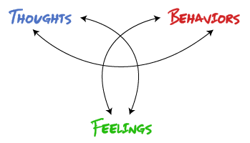
Tolerance for Uncertainty “Anxiety’s Kryptonite”
A skill we all have
Cognitive Reappraisal
Acceptance model
Notes:
The main treatment approach that I use for anxiety, depression and other diagnoses is CBT.
CBT is a problem-focused form of behavioral treatment that helps people understand the interplay between behavior, thoughts, and emotions. With greater awareness, understanding, and skill-building, people can learn to disrupt unhelpful patterns of behavior.
CBT is grounded in the understanding that the combination of a person’s perception of events, emotional experience, as well as social and physical environment determine how they will feel and act in response.
We want to develop tolerance for uncertainty. The primary treatment modality used, especially at our clinic, is cognitive behavioral therapy (CBT). Often when one is off, the others are impacted as well. Using evidence based techniques, like exposure therapy, cognitive reframing and behavioral activation, we are able to make changes in one or all of those categories. This yields positive outcomes .
Anxiety and uncertainty go hand in hand, they drive off one another so tolerance is anxiety’s kryptonite,
Learning to be comfortable with uncertainty and discomfort is crucial here
Going back to the fire alarm/false alarm example, our bodies register anxiety the same way, but it is our job to interpret it appropriately. If the fire alarm is going off, there is no way of knowing whether its burnt toast or the house is on fire. Same is true for our anxiety systems, we will start to feel anxious but then its important to look at the factors at play to see if it is a true warning sign to keep us safe and healthy, or if its a false alarm and then we need to reappraise the situation
Think of it as an oversensitive alarm system that goes off it you open the oven too fast - label it as such
Acceptance that this is a really difficult time and that things are different
have to accept the facts in order to move forward and start to feel better

Slide 9
Cognitive Reappraisal of Anxious Arousal “Don’t believe everything you think!”
Education regarding reality of danger
Education regarding fear response
Perspective of “curious observer”
“In this moment…”
Body is doing the right thing at the wrong time
Fire alarm - reframing as a “false alarm”
Label the anxiety disorder as a “bully”
Notes:
Education regarding reality of danger - talk about function of sympathetic vs. parasympathetic nervous system

Slide 10
Self-Efficacy “Why Doesn’t the Bird Fear the Branch Breaking”
An individual’s belief in his/her capacity to execute behaviors necessary to produce specific performance attainments
I know I can do it because…
Mastery experiences
Vicarious Experiences
Verbal Persuasion
Emotional States
Notes:
The bird doesn’t fear the branch it is sitting on not because it thinks the branch is strong but rather it knows it can fly if it does break or something else happens to it

Slide 11
What Anxiety Can Look Like
Inattention
Absenteeism
Defiance
Incomplete work
Irritability
Isolation
Notes:
Here are just a few that anxiety may present itself
Its important to be mindful of any of these symptoms showing up in your kids or students, that we need to work with them to cope effectively with anxiety because again, avoidance maintains anxiety, it reinforces it and makes it more likely to stick around. Using some of those effective coping skills is extremely beneficial in these situations.
Learning to know the difference between what is “normal” for your family/young adult and what seems to be a change from their baseline

Slide 12
Handling Strong Emotions “Thoughts are not evidence and feelings aren’t facts.”
“Don’t believe everything you think”
“Thoughts happen”
“Right now I’m having the thought/feeling that…”
Notes:
Having thoughts does not actually mean its going to happen. We all have millions of thoughts/day. Lets do a little exercise, I want everyone to think that they can turn the lights on and off with their mind. Ok GO, try it. Did it happen? Of course not. This is important because if someone is experiencing anxiety or intrusive thoughts (defined as unwanted, scary and anxiety provoking thoughts,) they may believe that their thoughts are gospel and that they must be true. We have to know that not everything we think is going to happen
A mindfulness approach is helpful here - thoughts happen. Thoughts are simply neurons firing in our brains. We as people have the choice to react and respond to certain thoughts. Like you may have had the thought to wear a particular outfit today or have something particular for breakfast. Thats an example of having a thought and acting on it. We have plenty of thoughts where we have a thought but then just notice it, without
Labeling the thought and the feeling Its ok to have scary thoughts but the scary thought itself isn’t scary - recognizing having a scary thought about it puts a little space between you and the thought (a preamble to the scary though)

Slide 13
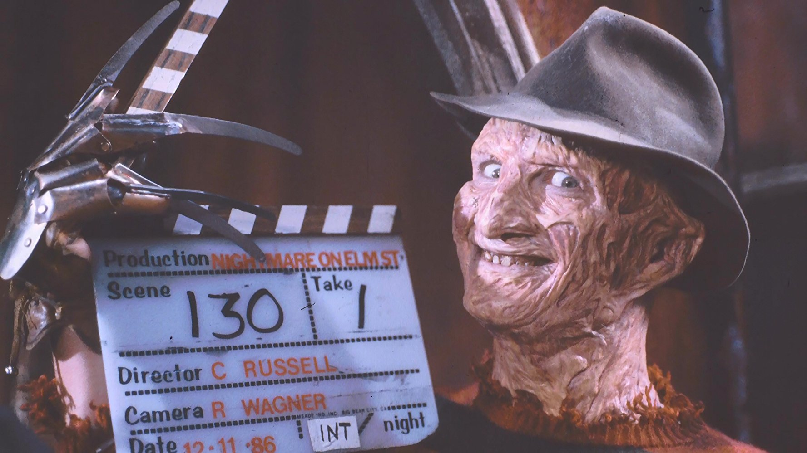
“Behind the Scenes Footage of Your Own Scary Thoughts”
Notes:
Sometimes just labeling and saying out loud - “I am feeling anxious” or “I am having a thought or a feeling that I am anxious”
It helps put a little bit of separation between self and the thoughts and allows for al little bit of a behind the scenes view - it also helps with that modeling of appropriate emotional expression that we were talking about earlier.
Ever watched a scary movie and then watch the behind the scenes making of it? Its totally different
Parents can model this behavior!!

Slide 14
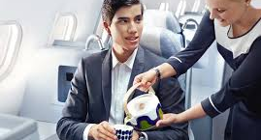
“Model what you want the child to feel.”
Notes:
Parents, teachers, caregivers can and need to model appropriate ways to cope with hard things
Showing them how to talk about their experiences, desirable behaviors, coping mechanisms.

Slide 15
Cognitive Coping Strategies: “Just because I feel scared doesn’t mean anything bad is going to happen”
Discuss importance of self-talk
Create “Coping Cards”
- Individually tailored to fear cues
Review appropriate situations in which to use each card
Pop-quizzes with rewards for successful recall
Notes:
Coping cards are extremely helpful for kids and teens (heck even adults), especially when we are trying to build up that sense of self efficacy
They have to learn to be their own cheerleaders and develop that internal self-talk skill.
Can make colorful cards and posters and put them all over their workspace to serve as reminders for when they are in class
Can think of these as mantras or slogans to help encourage. I grew up as an athlete and still participate in sport/activity and the use of these statements are still applicable as an adult. Both for fun and for work.

Slide 16
Coping Card Examples
“Fear is temporary and harmless”
“Scary thoughts can’t hurt me”
“Just because I feel scared doesn’t mean anything bad is going to happen”
“Just because I am scared doesn’t mean I can’t do it”
“Just because I feel sick doesn’t mean I’m going to throw up”
“I am stronger than my fear”
Notes:
Teach kids at an age appropriate level how to coach themselves through hard and scary times
Confuse thoughts with evidence - Omg that kid was laughing at me that means they don’t like me
Our scary thoughts are the things that scare us
Help kids develop the ability to cope themselves
Not telling kids there’s nothing to be afraid of because that can be invalidating rather tell them that they can cope with the thought

Slide 17
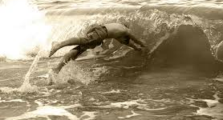
The way to respond to anxiety is just as counterintuitive as diving into the wave that’s about to hit you.”
Notes:
Another tactic to coping with anxiety is exposure. Exposure is all about confronting the variable we are wanting to desperately to avoid/the thing that is making us feel anxious.
Going back to learning to tolerate discomfort and uncertainty,
Needing to lean into anxiety and approach the things that are most scary and uncomfortable - exposure lifestyle

Slide 18
The Wave of Anxiety
“Escape line”
Person feels better instantly
because escape/avoidance is
reinforced
Notes:
When someone is feeling anxious and they are doing an exposure, or just approaching a situation that makes them feel uncomfortable, we want them to ride the wave. When anxiety starts to increase but then there is an opportunity for that person to get away from that distressing feeling, they are not learning how to cope with the feeling. Instead, avoidance is being reinforced and they are more likely to keep avoiding the situation more and more. Instead of escape, which can be a physical escape, avoidance, a parent or friend providing reassurance or other accommodation, we want the person to stick with it, even when they experience that peak intensity but then seeing that they can get through it.

Slide 19
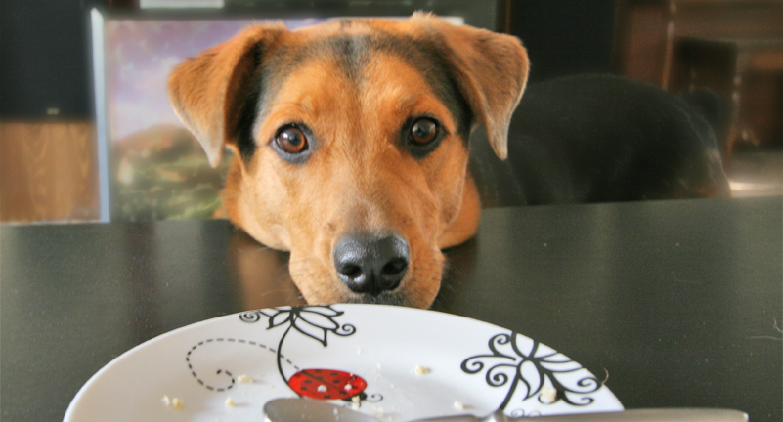
“I’ve given you what you want.
Now go away and never beg again.”
Why Providing Reassurance is a Trap!
Notes:
To piggyback off of the coping card and self talk statements, we do not want to provide reassurance, things like saying “oh you are fine, you’re OK, nothing is going to be bad etc)
reassurance perpetuates anxiety. Those types of statements teach people to to seek proximity to you as a way to cope with the feelings because you are telling them it will be safe and OK, instead of coping with the situation and learning to tolerate distressing feelings
In situations where there is a real threat or danger, it is OK to say things like, we are doing everything we can to stay safe and protect us.
Anxiety begs for avoidance and attention - like a dog asking for food. If you give it a bone and tell it to go away, its learning to keep coming back for more. We do not want to do this
We CAN reassure them of their strength and bravery and skillfulness to tackle hard situations. More important to validate and then encourage, even if it has to be with a compassionate/firmness approach
This can feel tricky as a parent because our gut is to protect and do anything we can for our kids. Thinking back to the escape line, if you provide reassurance to something they are scared of, they aren’t learning anything, they will only seek more reassurance to feel better.
Reassurance is the bandaid to a problem but after time it loses its sticky quality and you are left with the wound underneath

Slide 20
“No good caregiver would just give their child the answer. They need to learn how to solve it.”
Notes:
Counterintuitive - you wouldn’t tell a kid the answer to a math problem, rather you would help them learn how to solve the problem, guide them through it, step by step.
Teaches kids how to look inside themselves for effective coping skills instead of looking to a parent or a teacher for the solution

Slide 21
A Quick Note on Breathing…
Mindful Minute
Complete 5 rounds of 4-2-6 Breathing
Breath in for a count of 4
Hold for a count of 2
Exhale for a count of 6

Slide 22
Quick Review and Take Aways
Avoidance maintains anxiety!
Reinforcing desired behaviors/thinking patterns, NOT anxiety
Reassurance only maintains anxiety
Practice 4-2-6 breathing
Modeling appropriate and healthy ways to cope with stress and anxiety
Keeping routine and consistency and allowing for space to share
Increase self-efficacy
Validate and support

Slide 23
That’s A Wrap!

